Slide 1
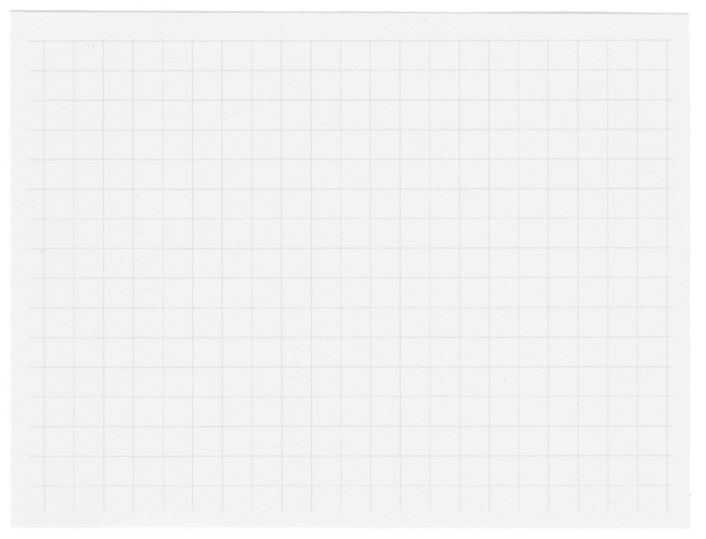













FYP Management System
Group 12: 21i-2495, 21i-2598, 22i-1270

Slide 2
01.
Agenda
Table of Contents
02.
Architecture
03.
User Stories
04
Conclusion

Slide 3
Agenda
Our project aims to optimize the management process of the final year projects. It is designed to reduce the time taken, minimize the paperwork and enhance the overall efficiency.

Slide 4
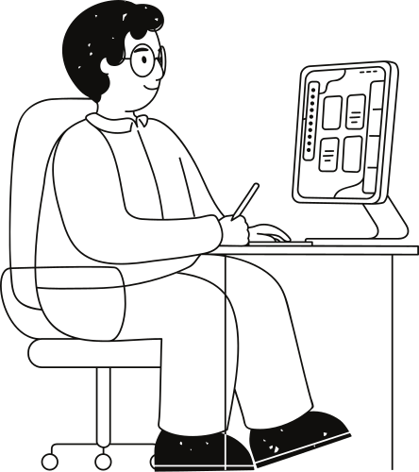
Architecture
three-tier layered architecture consisting of a presentation layer, business layer, and database layer.
presentation layer, implemented using HTML, CSS and Bootstrap
business layer contains the core logic and functionalities of the system
database layer is implemented using SQL

Slide 5
User Stories
Sprint 1:
User Story 1: Create user accounts
User Story 2: Assign User roles
User Story 7: Create Project Panels
User Story 8: Assign FYP groups to Panels
User Story 18: Access Assigned FYPs
User Story 12: View Assigned Panel
User Story 11: View Project Details
User Story 21: View all active FYPs
User Story 22: View details of each FYP
User Story 27: Communicate with Assigned Groups

Slide 6
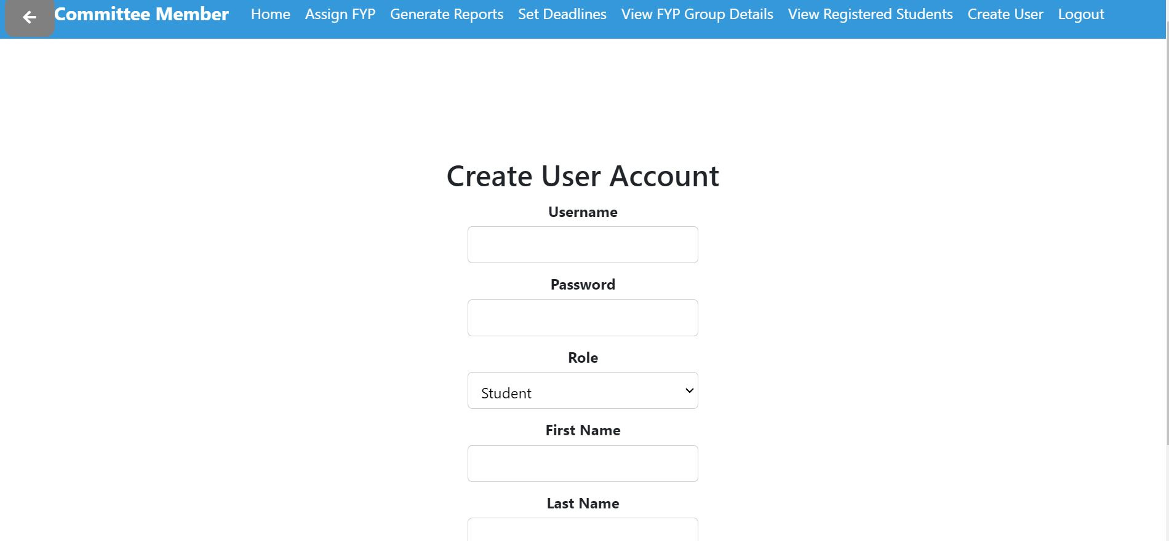
User Story: Create User Accounts

Slide 7
User Stories
Sprint 2:
User Story 6: Set project deadline
User Story 14: Checking deadlines
User Story 16: Uploading assignments/deliverables
User Story 25: View Deadline for all the FYP related assessments
User Story 17: Submitting progress report
User Story 28: Submit Request for Extra Material
User Story 29: Upload Supplementary Documents
User Story 23: Review Progress Reports
User Story 5: Generate project reports
User Story 3: Supervisor reaches max project allocation limit

Slide 8
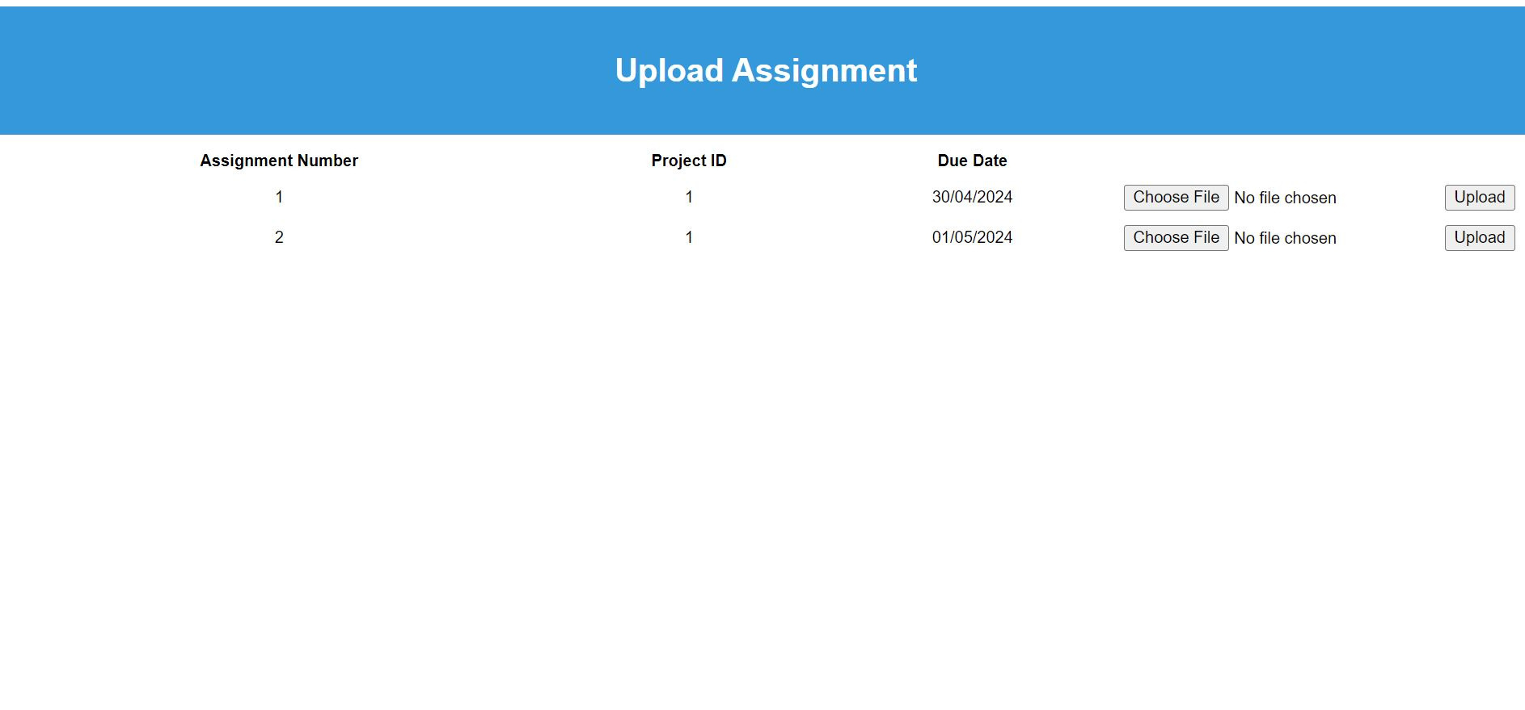
User Story: Uploading Assignment

Slide 9
User Stories
Sprint 3:
User Story 9: View Registered Students list
User Story 32: Offer Suggestions to FYP Panel Members
User Story 19: Evaluating FYPs
User Story 13: View Review & Suggestions
User Story 20: Handling Missing Evaluations
User Story 24: View FYP Material
User Story 10: View FYP group’s details
User Story 30: View Evaluation Forms and Grades
User Story 15: Review final grade

Slide 10
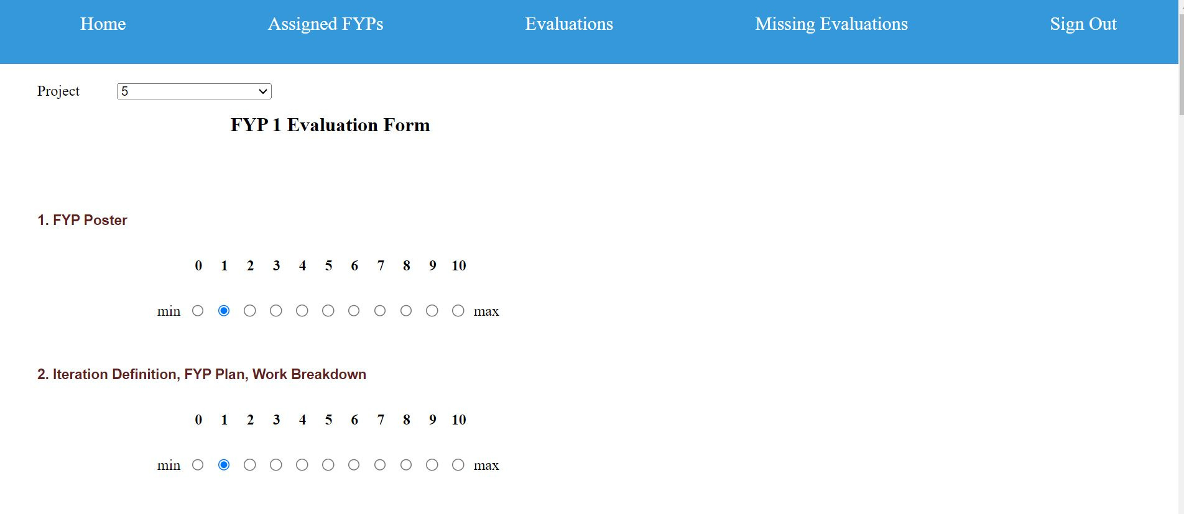
User Story: Evaluating FYPs

Slide 11
Conclusion
can be improved by refining the layout and adding modern design elements
architecture can be changed to the one having more number of layers in order to increase the security
can ensure that the system is compatible with mobile devices as well for user convenience

